Slide 1


Apex Solutions, Transforming patient care
September 27, 2025
  Noah Mathew, Heinric Alfred Vijay, Nethan Binu

Slide 2
Agenda
Let’s get started
01
Our Solution
  Our Problem Statement and Our Solution.
02
The Three Pillars
  Addressing the Three Pillars of the UST Hackathon.
03
Demo
  Demonstration of our optimizer.
04
Future Implementations
  The scablilty and importance.

Slide 3


Problem Statement and Solution
Problem Statement
Hospitals and ERs face recurring issues: long wait times, staff burnout, uneven resource use, and lack of transparency for patients.
Solution
Our Smart Healthcare Optimizer uses AI and quantum-inspired optimization to eliminate delays and ensure every patient is directed to the right doctor, room, and treatment instantly.
By combining predictive models, ethical data sharing, and modern optimization, we forecast patient inflow, dynamically allocate staff/equipment, and fairly prioritize critical cases.
This integrated, secure, and transparent system makes healthcare smarter, more efficient, and more sustainable — aligning with all three pillars of the UST Hackathon.

Slide 4
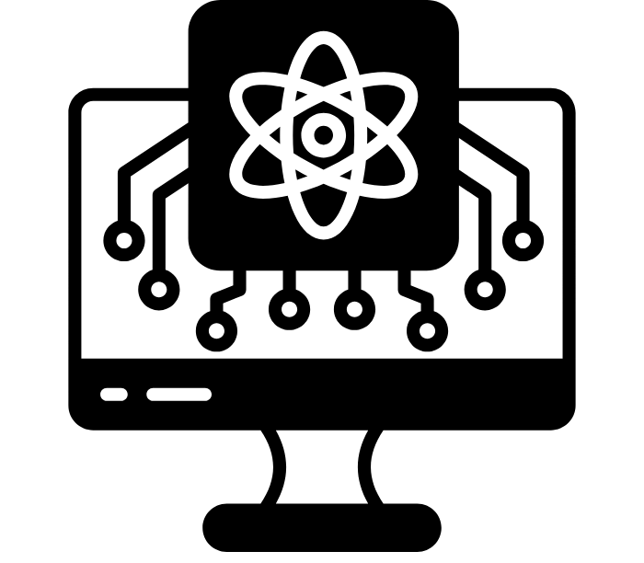
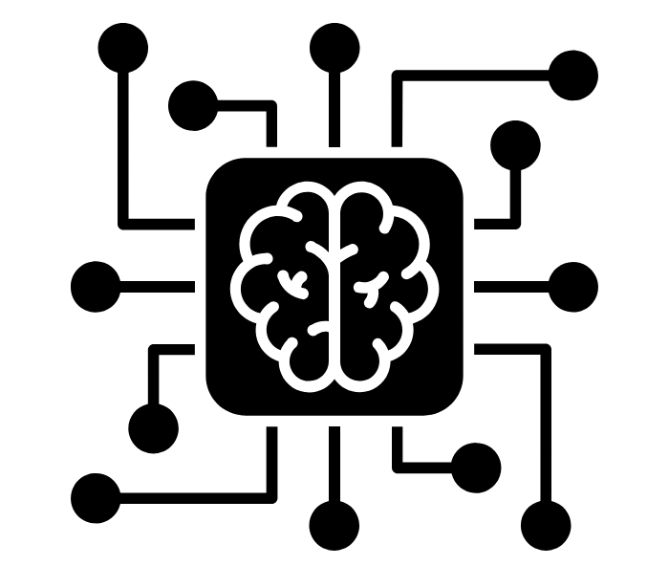

Three Pillars
Integration of AI
Utilizing AI concepts to forecast whether there is busy traffic in time slots. In doing so, patients can choose an appropriate time and be seen promptly.
Data Ecosystems
Integrating and managing diverse healthcare data sources to provide a unified, real-time view, supporting smarter operational and clinical decisions.
Quantum Computing
Rapidly assessing and prioritizing patients based on the severity of their conditions, enabling scalable and efficient scheduling decisions spontaneously.
Notes:
Grover's Algorithm for Patient Priority Optimization
Purpose: Uses quantum computing principles to efficiently find high-priority patients in the queue, providing exponential speedup over classical search algorithms.Algorithm Implementation:
1. Quantum State Preparation:N Qubits: Represents N patients in the queue (log₂(N) qubits)
Superposition: All patients start in equal superposition state
Marked States: High-priority patients are "marked" based on severity scores
2. Grover Iterations:Oracle Function: Identifies high-priority patients (severity > 7, emergency cases, critical conditions)
Diffusion Operator: Amplifies the probability of marked states
Optimal Iterations: √N iterations for maximum success probability
Data:
1. Forecasting Dataset (720 records)
File: forecasting_dataset.csvPurpose: Historical healthcare data for appointment optimizationColumns:date: Date of observation
hour: Hour of day (0-23)
patients_arrived: Number of patients arriving
flu_cases: Seasonal flu case count
staff_on_duty: Available staff members
Usage: Trains models to predict patient arrival patterns, seasonal disease burden, and optimal appointment times.
2. Patient Queue Dataset (40 records)
File: patient_queue_dataset.csvPurpose: Real-time patient queue simulation for quantum schedulingColumns:patient_id: Unique patient identifier
arrival_time: Time of arrival
severity_score: Medical urgency score (1-10)
department: Medical department (ER, Cardiology, etc.)
condition: Patient condition description
doctor_needed: Required specialist
wait_time_minutes: Current wait time
priority_level: Critical/High/Medium/Low
is_emergency: Emergency status flag
Usage: Provides realistic patient queue data for quantum algorithm testing and delay prediction.
3. OR Scheduling Dataset (50 records)
File: or_scheduling_dataset.csvPurpose: Operating room scheduling and resource managementColumns:surgery_id: Unique surgery identifier
patient_id: Patient identifier
procedure: Surgery type
duration_min: Estimated duration in minutes
surgeon: Assigned surgeon
anesthesia_team: Anesthesia team assignment
recovery_bed_needed: Post-surgery bed requirement
Usage: Trains models for surgery duration prediction, resource allocation, and OR optimization.
4. Transport Routing Dataset (80 records)
File: transport_routing_dataset.csvPurpose: Patient transport optimization within healthcare facilitiesColumns:transport_id: Unique transport identifier
patient_id: Patient identifier
origin: Starting location
destination: Target location
urgency: Transport priority level
est_travel_min: Estimated travel time
Usage: Optimizes patient transport routes and resource allocation for efficient facility operations.
AI:

Slide 5

Integration Of AI
Predictive Insights with Random Forest
Uses Random Forest models to forecast patient severity and expected inflow.
Helps prioritize patients dynamically based on predicted risk and urgency.
Supports data-driven decisions for staff allocation and treatment planning.
Integrates seamlessly with the quantum optimization layer for efficient triage.

Slide 6
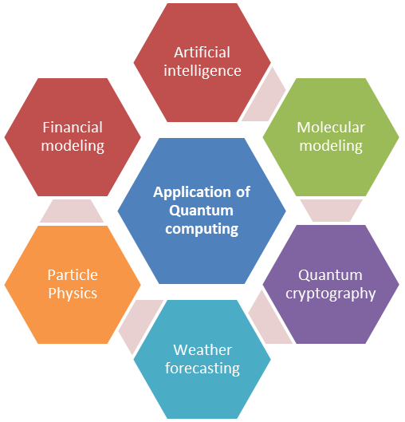
Quantum Computing
Grover-Based Optimization
Grover’s algorithm is used to efficiently find top-priority patients in large datasets.
It offers quadratic speedup over classical search, making it faster and more accurate.
Excels in highlighting critical cases where classical methods may take longer.
Works together with AI predictions for optimal patient allocation and scheduling.
Notes:
•On this slide we’re showcasing how we used Grover’s algorithm — a quantum search technique — to supercharge our system.
•Grover’s algorithm is a well-known method from quantum computing that can search unsorted datasets much faster than traditional methods. While a classical system checks each record one by one, Grover uses quantum parallelism and amplitude amplification to zero in on the right answers.
•Why does that matter? In healthcare, especially during peak hours, the patient queue can be massive. Grover’s algorithm lets us rapidly identify the highest-priority patients — the ones who need immediate care — so they don’t get buried in the crowd.
•We also pair Grover with our AI models, such as our Random Forest classifier, which predicts patient severity and needs. Those predictions feed directly into Grover, which then amplifies the probability of finding the top cases. This combination means we’re not only predicting who’s at risk but also prioritizing and allocating resources — doctors, rooms, and equipment — faster and more fairly.
•The end result is a hybrid AI + Quantum approach that reduces wait times, improves emergency response, and shows how quantum computing can already provide real-world benefits in healthcare operations. In short, Grover’s algorithm acts as the quantum engine behind our smart healthcare optimizer — making it both faster and smarter than a purely classical system.”

Slide 7

Demo

Slide 8
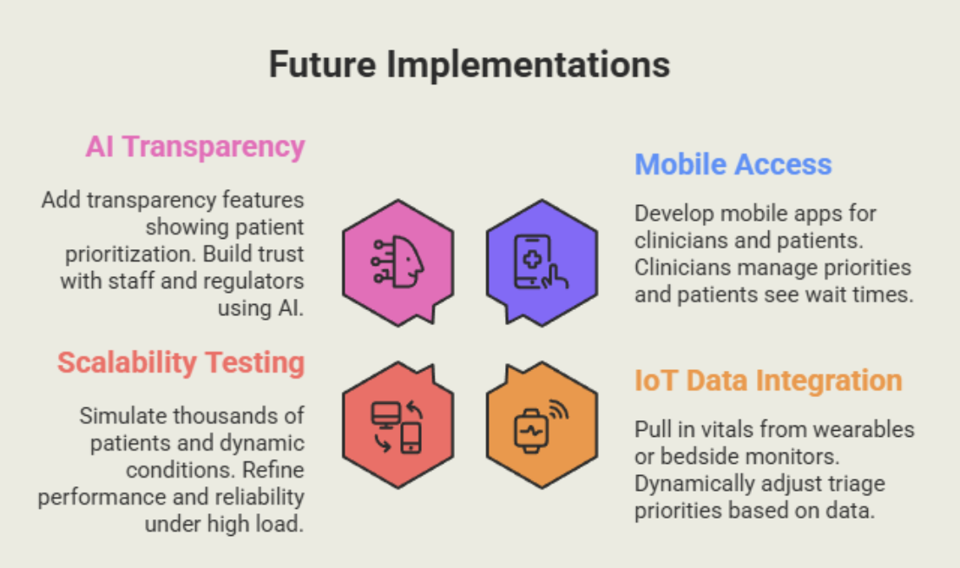
The Next Steps

